Slide 1
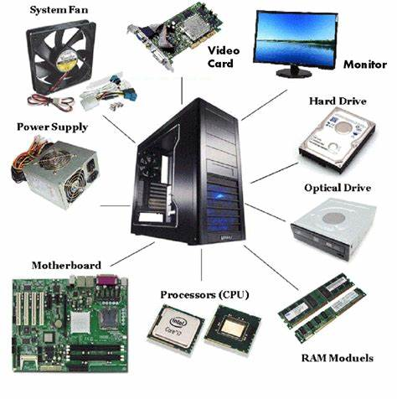
COMPUTER HARDWARE :

Slide 2
INPUT AND OUTPUT UNIT:
INPUT:
In computer input unit is defined as an input device, a piece of computer hardware apparatus used to supply a data processing system including a computer or information device with control and data signals.
Examples of input device:
Mouse, keyboards, scanners, joysticks, and digital cameras.

Slide 3
OUT PUT
An output device is any device that is used to transmit a computer’s data between devices or client. The bulk of computer output data designed for people is in audio or video format.
Examples of output device:
Projectors, monitors, microphones, printers and headphones.

Slide 4
MEMORY UNIT:
The memory unit is a component of a computer system.
It is used to store data, instructions and information.
It is also known as a principal/primary/internal memory.
Memory unit stores information
Each computer contains two types of memory unit
1.RAM
2.ROM

Slide 5
RAM AND ROM:
Random-access memory (RAM):-
RAM is also part of the memory unit, and it is used for the temporary storage of program data.
Read-only memory (ROM):-
ROM is a part of the memory unit. This is read only memory, and it can not be used to write.

Slide 6
ALU AND CPU:
Arithmetic logic unit :
It is a major component of the central processing unit of a computer system. It does all processes related to arithmetic and logic operations that need to be done on instruction words. In some microprocessor architectures, the ALU is divided into the arithmetic unit (AU) and the logic unit (LU).
Function of ALU:
The arithmetic logic unit is split into AU (arithmetic unit) and LU (logic unit). The operands and code used by the ALU tell it which operations have to perform according to input data. When the ALU completes the processing of input, the information is sent to the computer's memory.

Slide 7
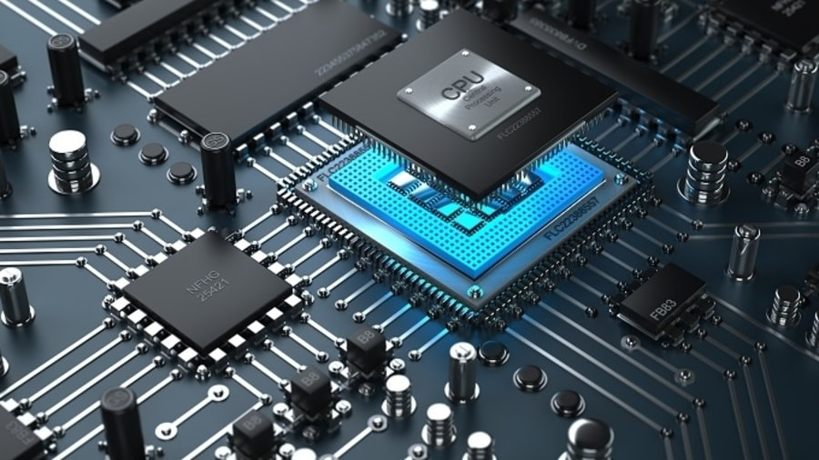
Control Processing unit:
It manages and coordinates all the units of the computer.
It does not process or store data.
It is responsible for controlling the transfer of data and instructions among other units of a computer.
The unit supervises the overall operation of the computer.

Slide 8
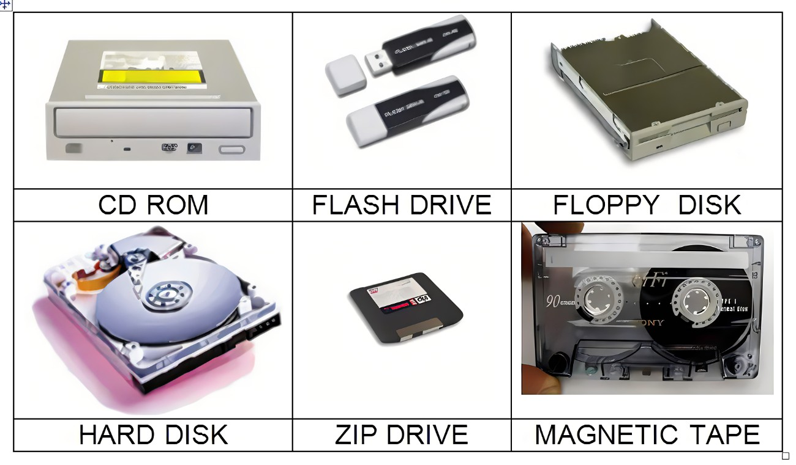
SECONDARY STORAGE:
Secondary storage devices are used to be parament storage area for programs and data.
Alternatively referred to as external memory, secondary memory, and auxiliary storage, a secondary storage device is a non-volatile device that holds data until it is deleted or overwritten.

